Slide 1

Persuasive Presentations
Session VI: Groups & Teams (In) Action

Slide 2
Chapter outlines
What Is Persuasion?
Meeting the Listener’s Basic Needs
Speaking Ethically and Avoiding Fallacies
Elevator Speech

Slide 3
LEARNING OBJECTIVES
By the end of this section, you will be able to:
Demonstrate an understanding of the importance of persuasion.
Describe similarities and differences between persuasion and motivation.
Identify and describe several basic needs that people seek to fulfill when they communicate.
Demonstrate the importance of ethics as part of the persuasion process.
Identify and provide examples of eight common fallacies in persuasive speaking.
Discuss the basic parts of an elevator speech.
Create an effective elevator speech.

Slide 4
Getting Started
Please list three things that you recently purchased, preferably in the last twenty-four hours—the things can be items or services.
Decide which purchase on your list stands out as most important to you and consider why you made that purchase decision. See if you can list three reasons.
Now pretend you are going to sell that same item or service to a friend—would the three reasons remain the same, or would you try additional points for them to consider?
Compare your results with a classmate.

Slide 5
1. What Is Persuasion?
Persuasion is an act or process of presenting arguments to move, motivate, or change your audience
Persuasion can be implicit or explicit and can have both positive and negative effects.

Slide 6
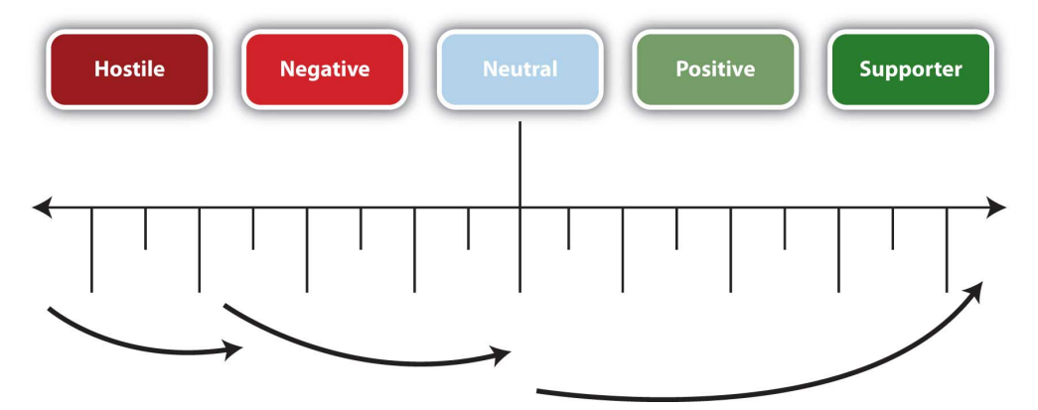
Measurable Gain

Slide 7
2. Meeting the Listener’s Basic Needs
How to meet the listener’s basic needs is central to effective communication?
Getting someone to listen to what you have to say involves a measure of persuasion, and getting that person to act on it might require considerable skill.

Slide 8
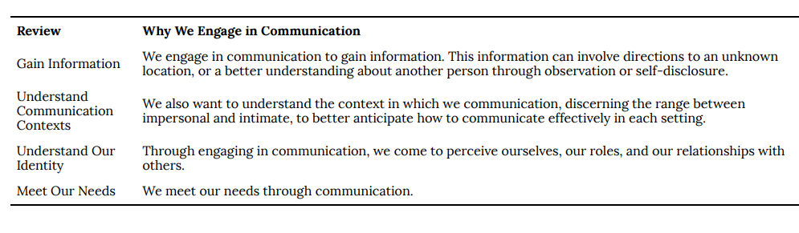
Reasons for Engaging in Communication

Slide 9
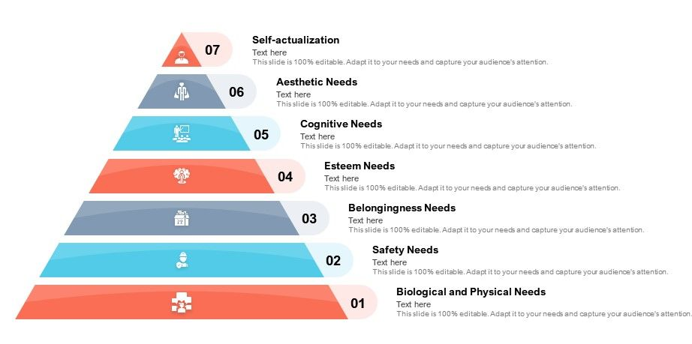
Maslow’s Hierarchy

Slide 10
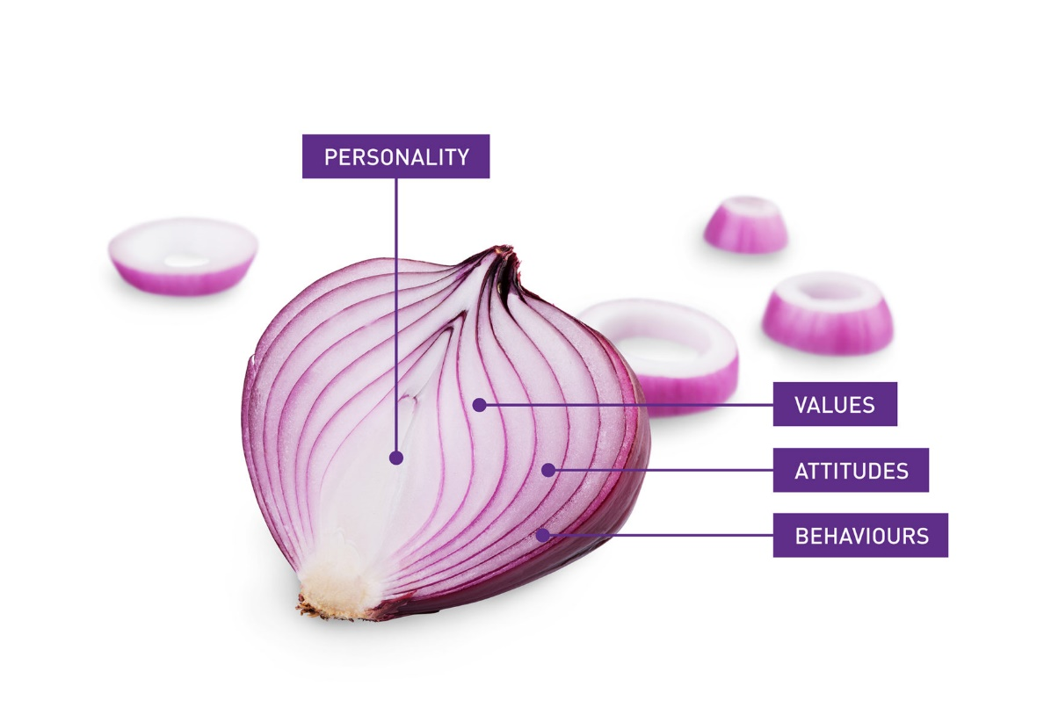
Social Penetration Theory
The social penetration theory, which describes how we move from superficial talk to intimate and revealing talk (Altman, I. and Taylor, D., 1973).
“Onion model”: we see how we start out on superficial level, but as we peel away the layers, we gain knowledge about the other person that encompasses both breadth and depth.

Slide 11
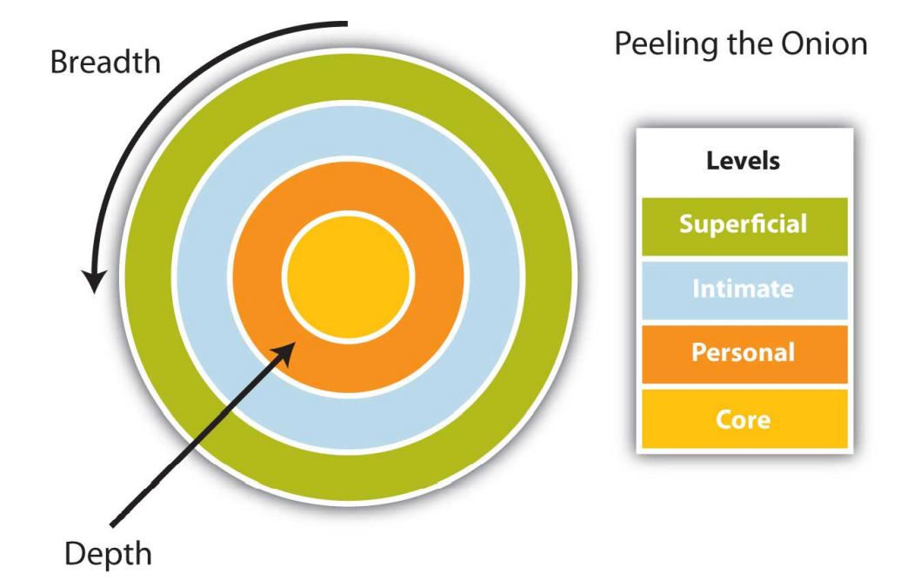
Altman and Taylor’s Social Penetration Model

Slide 12
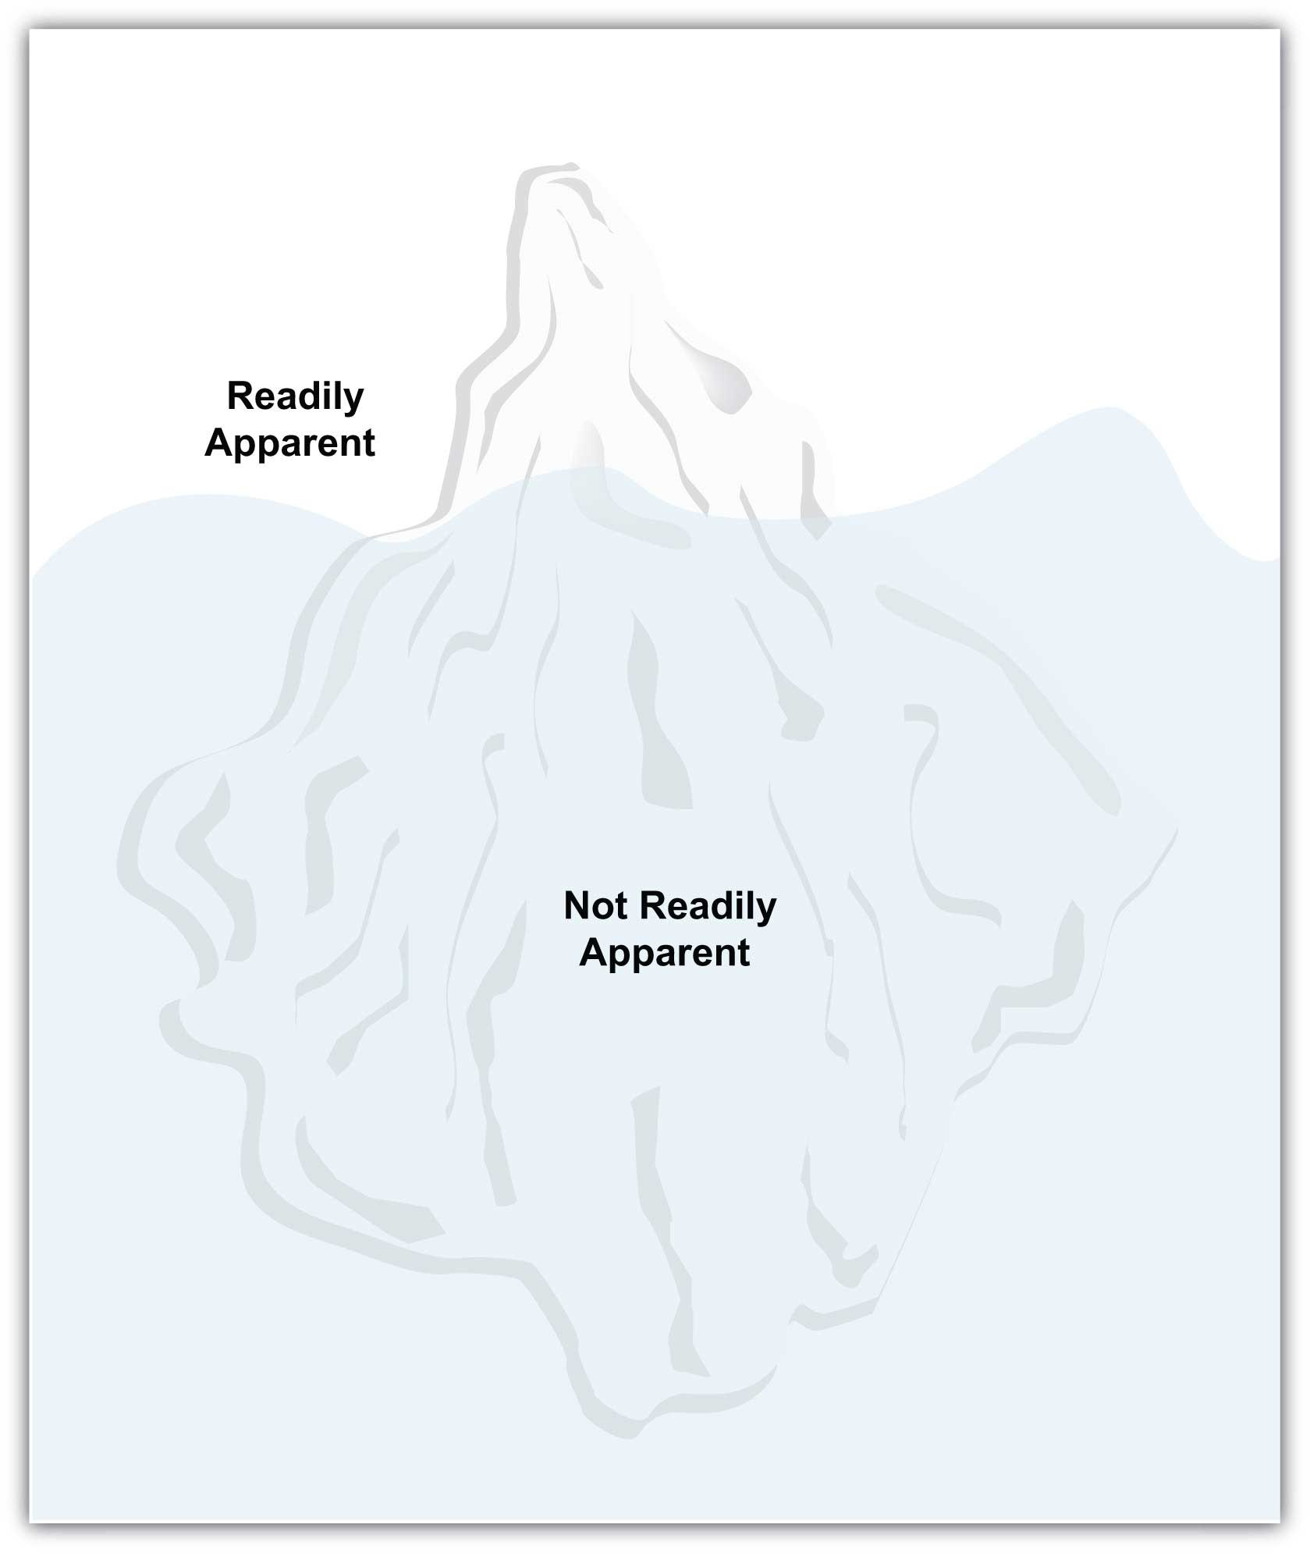
American Foreign Service Manual Iceberg Model

Slide 13
3. Speaking Ethically and Avoiding Fallacies
Fairness
Freedom
Ethics
Manipulation
Deception
Bias
Bribery
What comes to mind when you think of speaking to persuade?

Slide 14
Eleven Points for Speaking Ethically
Use false, fabricated, misrepresented, distorted or irrelevant evidence to support arguments or claims.
Intentionally use unsupported, misleading, or illogical reasoning.
Represent yourself as informed or an “expert” on a subject when you are not.
Use irrelevant appeals to divert attention from the issue at hand.
Ask your audience to link your idea or proposal to emotion-laden values, motives, or goals to which it is actually not related.
Deceive your audience by concealing your real purpose, by concealing self-interest, by concealing the group you represent, or by concealing your position as an advocate of a viewpoint.
7. Distort, hide, or misrepresent the number, scope, intensity, or undesirable features of consequences or effects.
8. Use “emotional appeals” that lack a supporting basis of evidence or reasoning.
9. Oversimplify complex, gradation-laden situations into simplistic, two-valued, either-or, polar views or choices.
10. Pretend certainty where tentativeness and degrees of probability would be more accurate.
11. Advocate something which you yourself do not believe in.

Slide 15
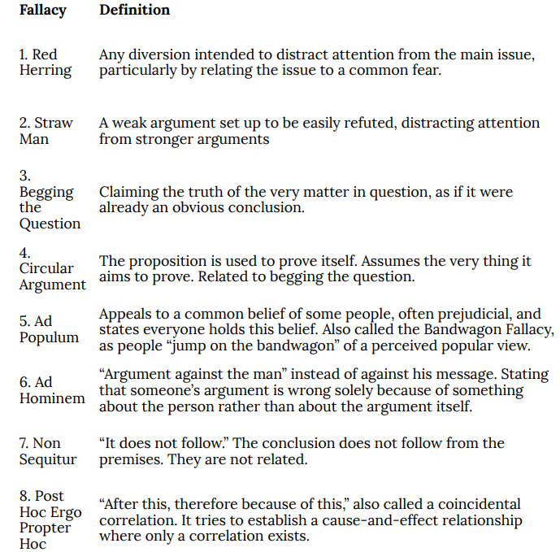
Avoiding Fallacies

Slide 16
Avoid mistakes by:
Get their attention
Identify the need (i.e., Problem)
Satisfy the need (i.e., Solution to the problem)
Present a vision or solution
Take action

Slide 17
4. Elevator Speech
An elevator speech is a presentation that persuades the listener in less than thirty seconds, or around a hundred words.
It takes its name from the idea that in a short elevator ride (of perhaps ten floors), carefully chosen words can make a difference.

Slide 18
Creating an Elevator Speech
What is the topic, product or service?
Who are you?
Who is the target market? (if applicable)
What is the revenue model? (if applicable)
What or who is the competition and what are your advantages?

Slide 19
Parts of an Elevator Speech
Speech Component | Adapted to Elevator Speech
Attention Statement | Hook + information about you
Introduction | What you offer
Body | Benefits; what’s in it for the listener
Conclusion | Example that sums it up
Residual Message | Call for action

Slide 20
Example:
1. How are you doing?
2. Great! Glad you asked. I’m with (X Company) and we just received this new (product x)—it is amazing. It beats the competition hands down for a third of the price. Smaller, faster, and less expensive make it a winner. It’s already a sales leader. Hey, if you know anyone who might be interested, call me! (Hands business card to the listener as visual aid)

Slide 21
Activity
Prepare an elevator speech (no more than thirty seconds) and present to the class.

Slide 22
Key Takeaway
Persuasion is the act of presenting arguments for change, while motivation involves the force to bring about change. The concept of measurable gain assesses audience response to a persuasive message.
We are motivated to communicate in order to gain information, get to know one another, better understand our situation or context, come to know ourselves and our role or identity, and meet our fundamental interpersonal needs.
Speaking to persuade should not involve manipulation, coercion, false logic, or other unethical techniques.
You often don’t know when opportunity to inform or persuade will present itself, but with an elevator speech, you are prepared!

Slide 23
Exercises
Select an online advertisement that you find particularly effective or ineffective. Why does it succeed, or fail, in persuading you to want to buy the advertised product? Discuss your ideas with your classmates.
1. Consider your life in relation to Maslow’s hierarchy of needs. To what degree do you feel you have attained the different levels in the hierarchy? Two or three years ago, were you at the same level where you currently are, or has your position in the hierarchy changed? In what ways do you expect it to change in the future? Discuss your thoughts with your classmates.
Think of someone you have met but do not know very well. What kinds of conversations have you had with this person? How might you expect your conversations to change if you have more opportunities to get better acquainted? Discuss your thoughts with a classmate.
Find an example of an elevator speech online (YouTube, for example) and review it. Post the link and a brief summary of strengths and weaknesses. Share and compare with classmates

Slide 24


